Slide 1
Hole Making Operations

Slide 2
About drilling
Drilling is the operation of making holes in a work piece using drill bit.
Tool used – Twist Drill
Consist of helical groove (FLUTE) along the length of the body
Machine used – Drilling Machine
The stationary work is held in a fixture and the rotating tool is fed vertically down.
Removes the material, layer by layer
Chips get curled and escape through the groove

Slide 3
Twist Drill Bit

Slide 4
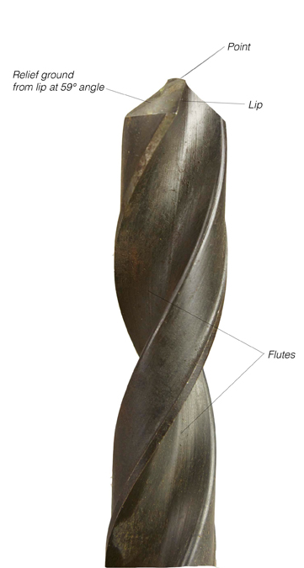
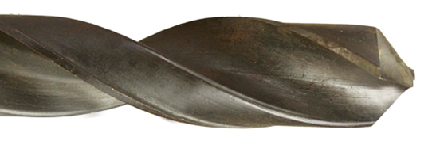

Slide 5
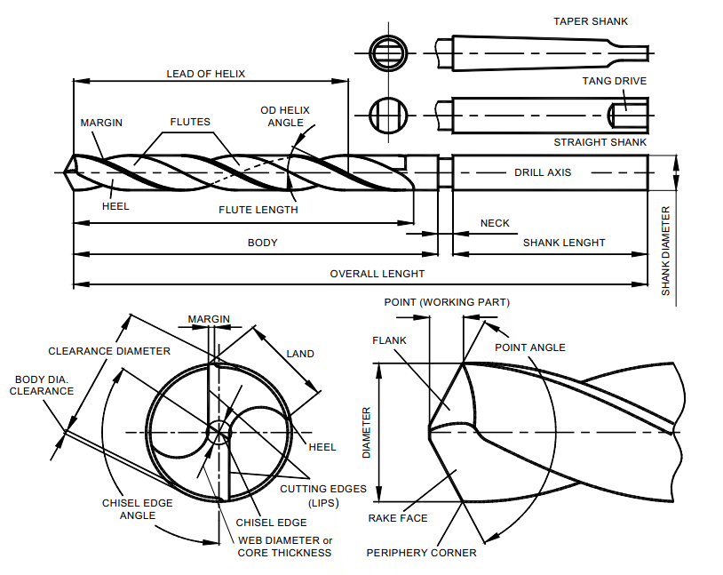

Slide 6
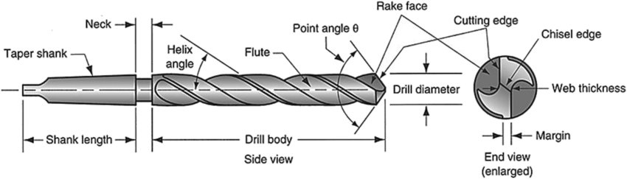

Slide 7
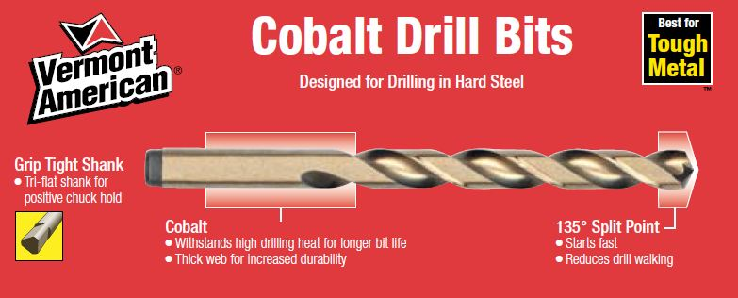

Slide 8
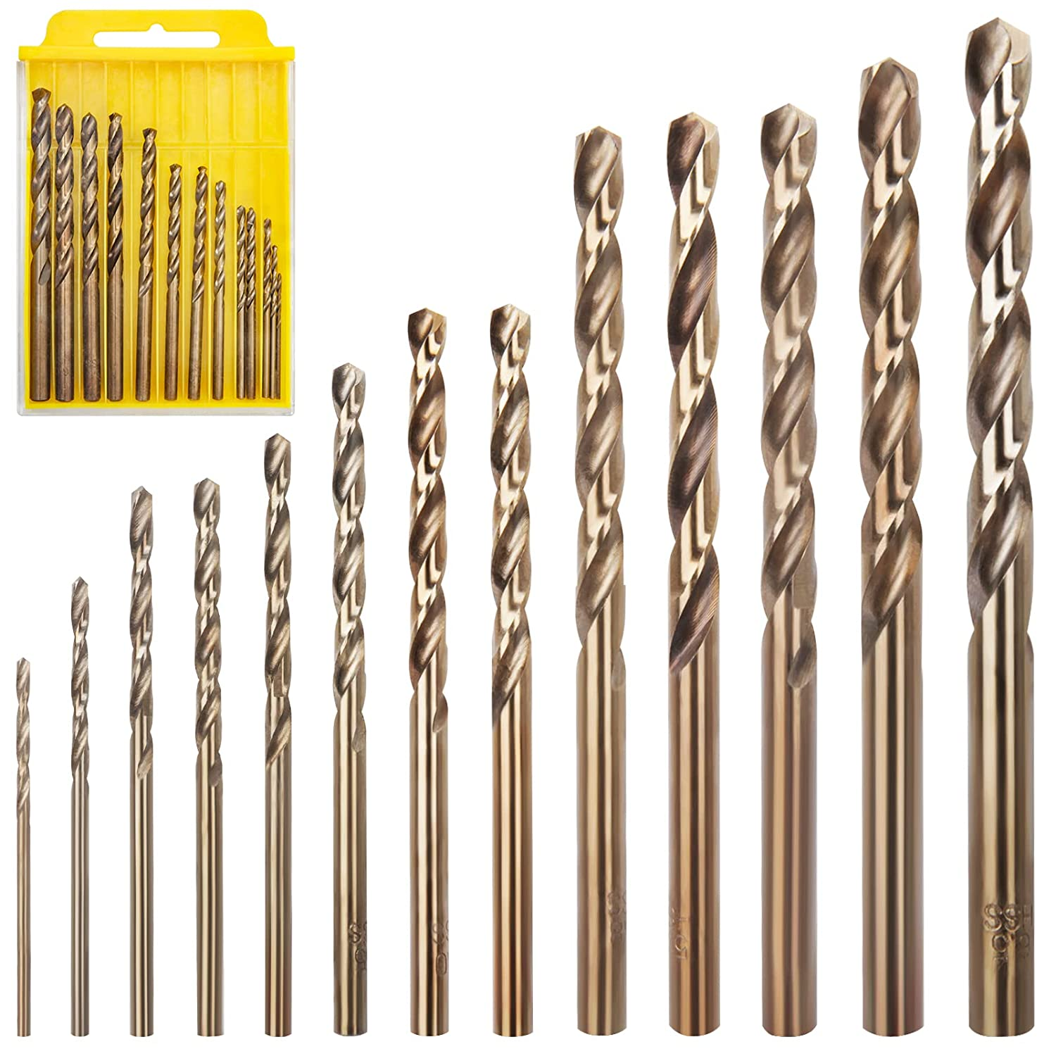

Slide 9
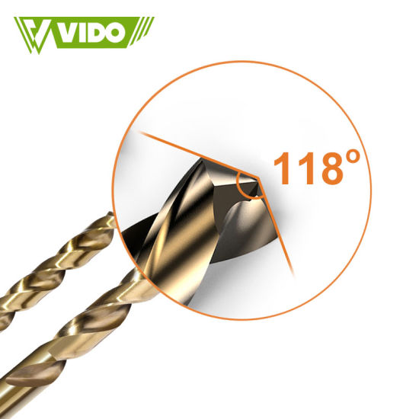

Slide 10
WHAT IS DRILLING?
Drilling is a metal cutting process carried
out by a rotating cutting tool to make
circular holes in solid materials.

Slide 11
What is a Drilling Machine?
A power operated machine tool, which holds the
drill in its rotating spindle and when manually
actuated to move linearly against the work piece
produces a hole.

Slide 12
Why coolant is used during machining?
To remove the heat of friction
To provide better finish to the hole

Slide 13
Types of Drilling Machines
Drilling machines may be classified as
Portable drilling machine.
Bench or sensitive drilling machine.
Radial drilling machine.
Upright drilling machine.
Gang drilling machine.
Multiple spindle drilling machine.

Slide 14
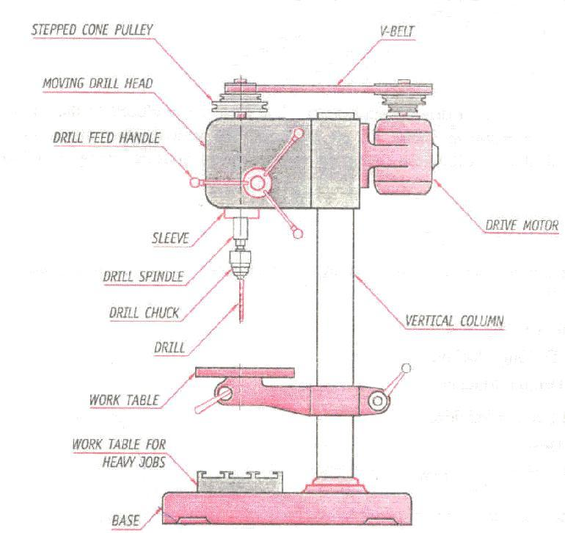
Bench Drilling Machine

Slide 15
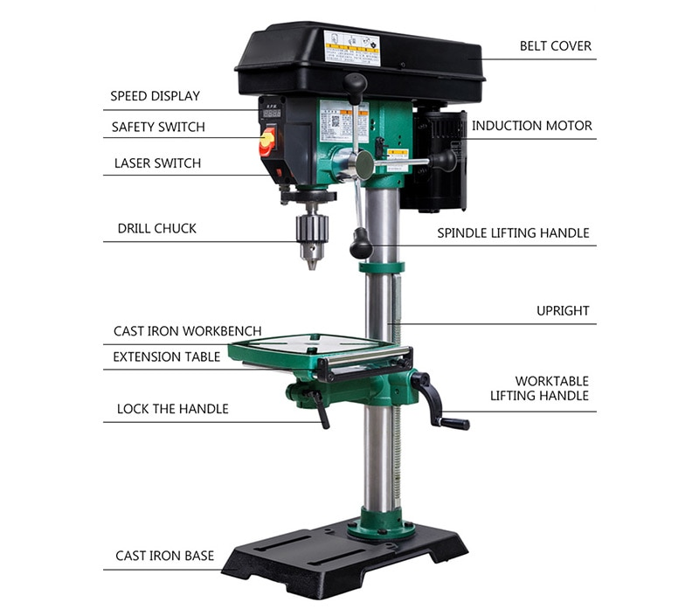

Slide 16
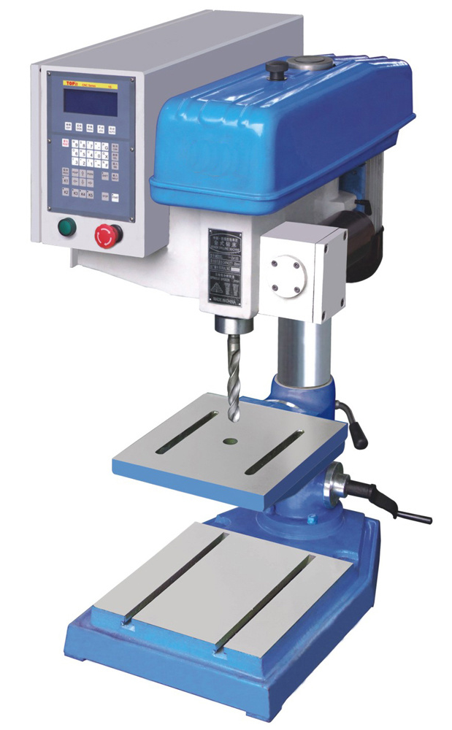

Slide 17
Bench Drilling Machine
Located generally on the work bench hence the name bench drilling
Since it is used for small jobs, it is also referred to as sensitive drilling machine.
Used for drilling small and medium sized holes (up to 15mm ).
It consists of a round column with a rigid base fastened to the bench
Has a work holding table and an arm mounted on the round column
Arm carries the drill spindle on one side and the drive motor on the other side
A stepped cone pulley with V – belt is used to transmit the power from motor to spindle

Slide 18
Bench Drilling Machine
The work table can be moved up and down to suit the required job height and can be locked at suitable height
The arm can swing around to set the work below the drill bit. The table can rotate about its axis by 360°
The drilling operation is performed by fixing the job properly on the work table
The drill bit is gradually fed by rotating hand feed lever towards the operator
Once the required depth of cut is completed, the feed lever is rotated in the opposite direction to withdraw the tool from the work
Complete operation is done manually

Slide 19
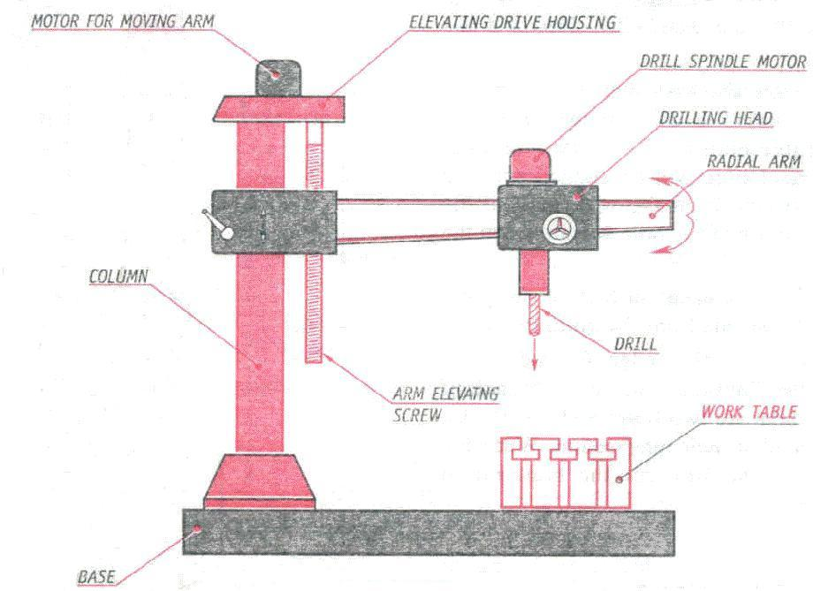
Radial Drilling Machine

Slide 20
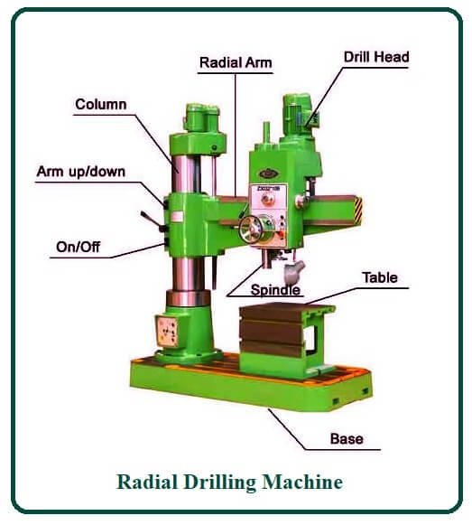

Slide 21
Radial Drilling Machine
Radial drilling machine is used for medium and heavy duty applications
Consists of a heavy, circular column mounted on a very strong base
Radial arm that can swing around is mounted on the column and the radial arm can be raised and lowered
Drill head with drive and feed mechanism is fitted on to the radial arm
Drill head can move horizontally along the slides of the arm and can be locked at any desired position
These movements of the arm and the drill head make it easier and faster to locate the drill centre on the work
All the motions can be clamped at necessary positions

Slide 22
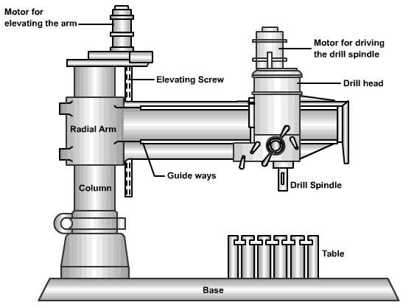

Slide 23
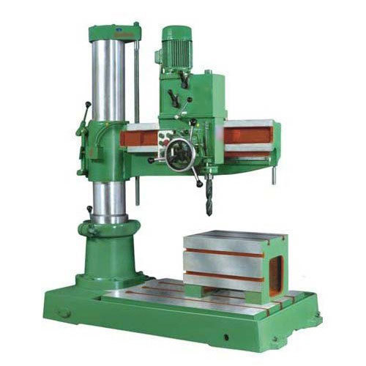

Slide 24
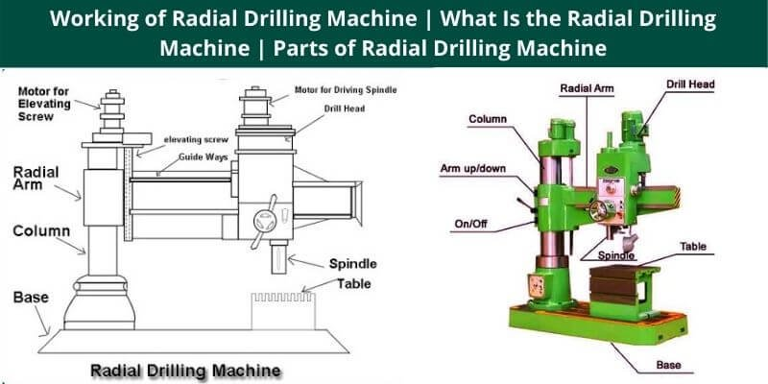

Slide 25
Other operations that can be performed on a
drilling machine are:
Reaming
Counter boring
Counter sinking
Spot facing
Thread tapping

Slide 26
List the operation performed on a drilling machine.
The different machining operations that can be performed
operation performed on a drilling machine are as follows.
Drilling
Reaming
Boring.
Counter Boring
Counter sinking
Spot facing
Tapping.
Trepanning

Slide 27
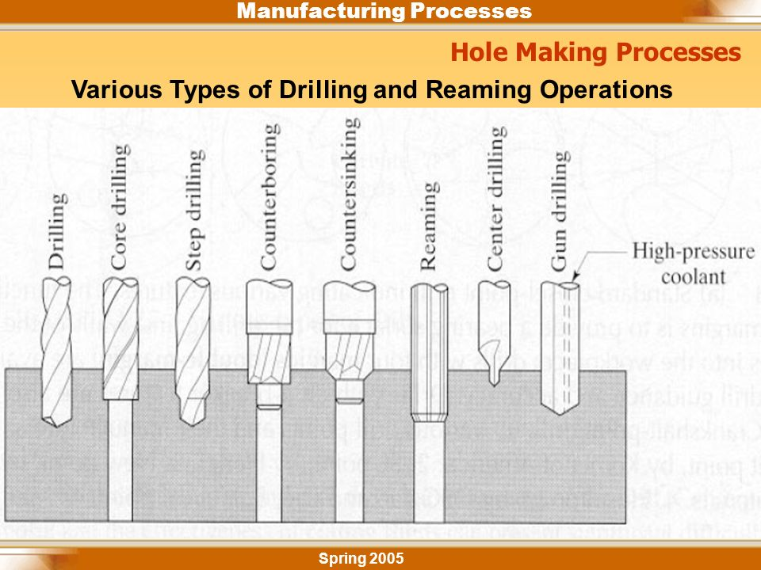

Slide 28
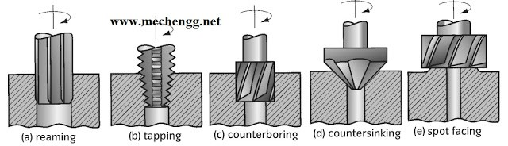

Slide 29
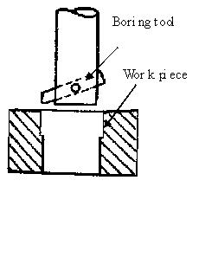
Boring:
Done on a drilling machine to
increase the size of an
already drilled hole
When a suitable size drill is not
available,
Initially a hole is drilled to
the nearest size
Using a single point cutting
tool, the size of the hole is
increased to required size
By lowering the tool while it is continuously rotating,
The size of the hole is
increased to its entire depth.

Slide 30
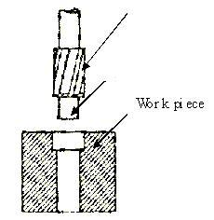
Counter bore Tool
Counter boring
It is to increase the size of a hole at one end only through a small depth
It forms a larger sized recess or a shoulder to the exiting hole
The cutting tool will have a
small cylindrical projection
known as pilot
It guides the tool
Pilot

Slide 31
Counter boring
Counter bore Tool
Condition:
Diameter of the pilot will always be equal to the diameter of the previously drilled hole
Cutting Speed:
Two-third of the drilling speed
Pilot
Purpose:
It is done on the hole to accommodate the socket head screw, or grooved nuts, or round head bolts.

Slide 32
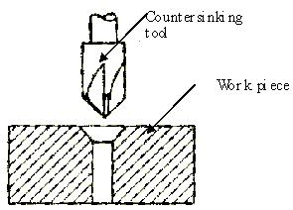
Countersinking
It is the operation of making
the end of the hole into a
conical shape
Using countersinking tool
May also be employed for deburring the holes
Cutting speed
One - half of that used for
similar size drill
Use:
When the countersunk screws are to be screwed into the holes, so that their top faces have to be in flush with the top surface of the work piece.

Slide 33
